Slide 1
External Evaluation Process
Exam | Marks | Syllabus | No. of Qstns to solve | Passi ng | Combin e passing
Insem | 30 | Unit 1, 2 | 2/4 | 0 | 40
End sem | 70 | Unit 3, 4, 5, 6 | 4/8 | 28

Slide 2
Exam form filling process
Generate ABC id
Generate profile at sps
Fill exam form

Slide 3
Step 1: Generate ABC id
Step 1: Go to the website at https://www.abc.gov.in
Step 2: Go to the “Account” section and click at the “Student” link.
Step 3: Then Sign up with DigiLocker and complete the ABC Scheme student registration process by providing the requisite details.
https://www.youtube.com/watch?v=PgJM0o5RiP4

Slide 4


SPPU
EXAMINATION FORM FILLING PROCESS (FE)
Phase-I: Student Profile
  Create Account (Required: Valid Email ID, Mobile Number & Aadhaar Number)
•
Course Enrollment (Required: College PUNCODE , Current Course Details & Previous Exam Details)
Personal Information (Required: Student Name, Father Name, Mother First Name,
Student DOB, Soft Copy of Student Photo & Signature)
•
Phase-II: Exam Form Filling (Required: Information about Current YearPattern
Details Required Before Filling Online Exam Form:
Passport Size Photo (Soft Copy JPG/JPEG Format Less than 300 kb Size)
Signature (Soft Copy JPG/JPEG Format Less than 50 kb Size)
Previous Exam Marksheet (Diploma/Bsc.)
Aadhaar Card

Slide 5

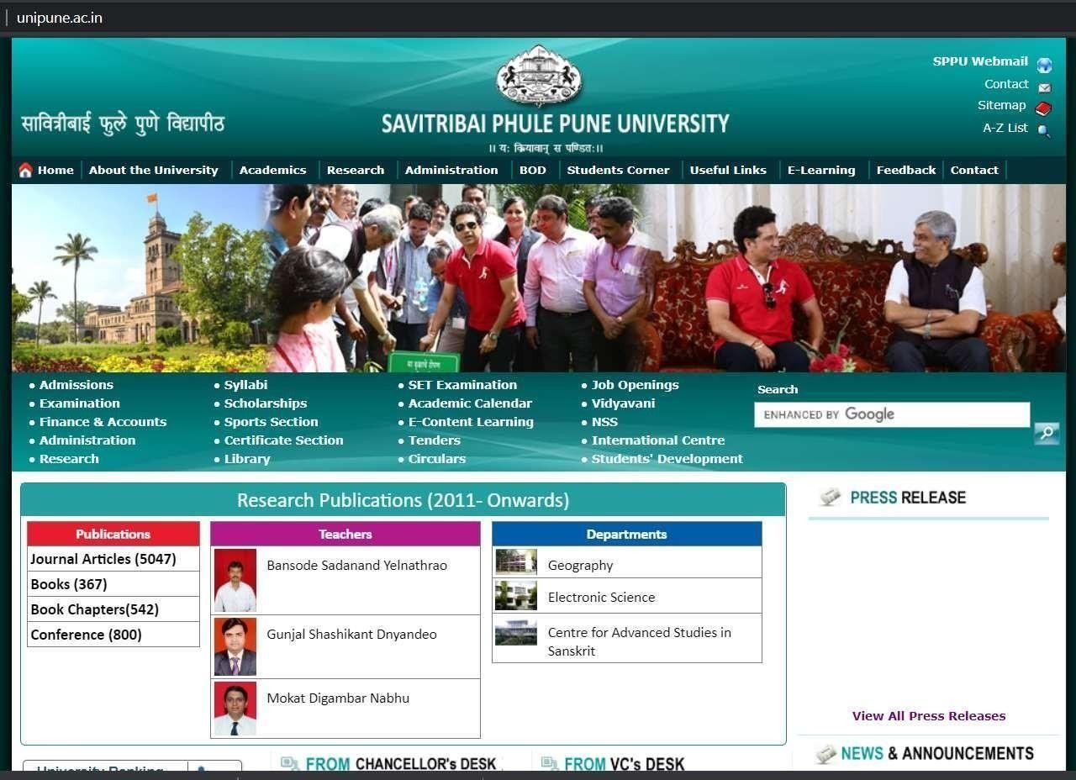
SPPU EXAMINATION FORM FILLING PROCESS
Official Website of SPPU: www.unipune.ac.in
Step1: Open SPPU Official Website www.unipune.ac.in
Click on “ Examination”

Slide 6

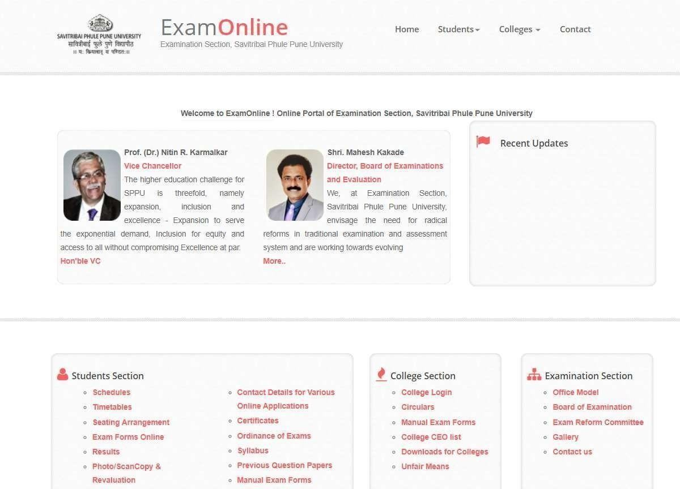
Step2:
Click on
“ Exam Forms Online”

Slide 7

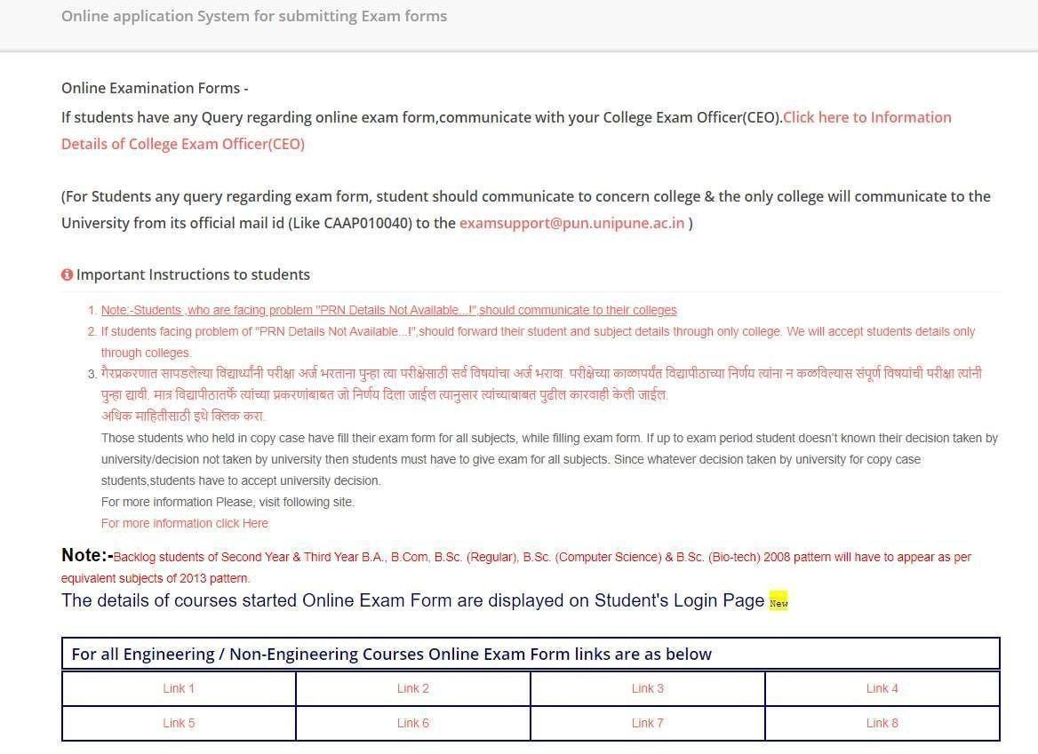
Step3:
Click on any one Link
“ Link 1 to Link 8”

Slide 8

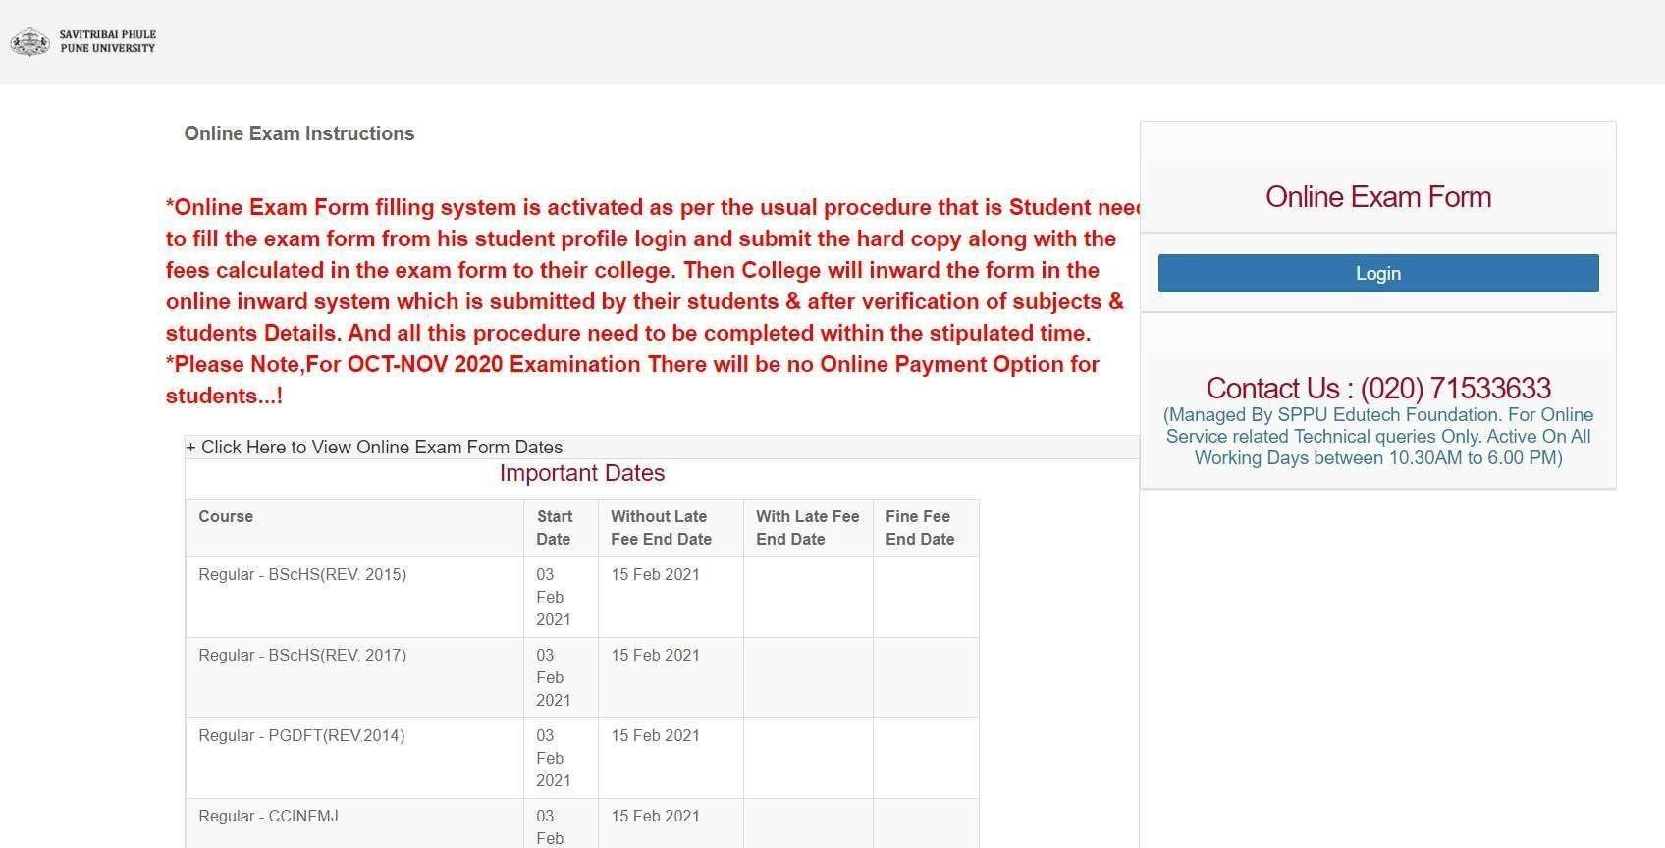
Step 4:
Click on “ Login”

Slide 9

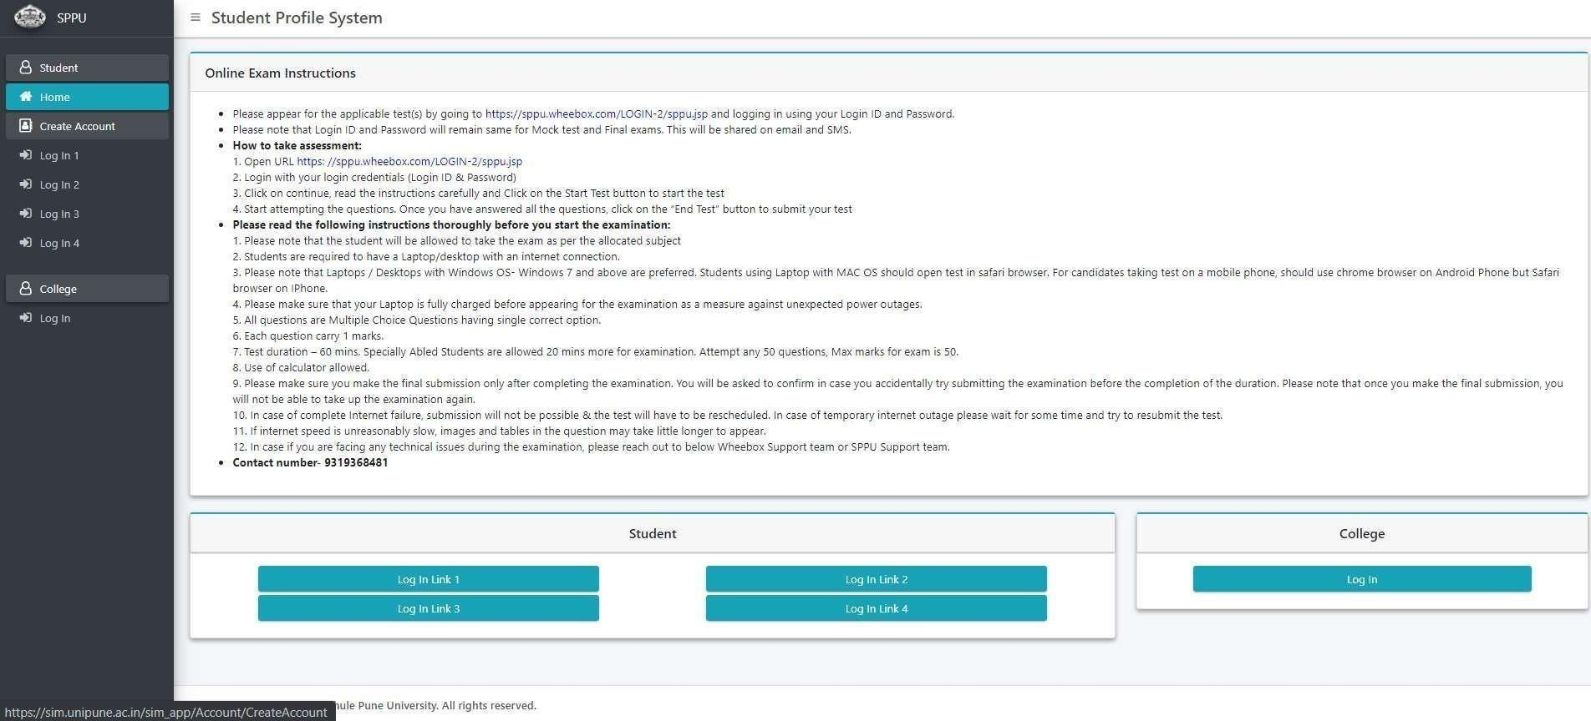
Step 5:
Click on
“ Create Account”

Slide 10

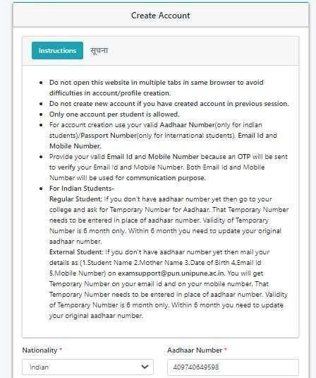
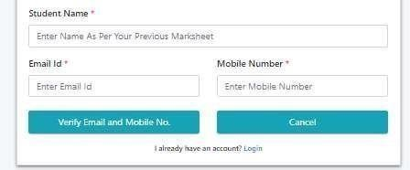
Step 6: Very Important Step Select or Enter the correct Details
Enter “Aadhaar Number”
Enter Name as per Previous Exam
Marksheet.
Enter Correct Email ID & Mobile No. of Student (Do Not Use Parent details).
Click on “Verify Email and Mobile No.”
(Immediately OTP will be senton Email ID & Mobile No.)

Slide 11

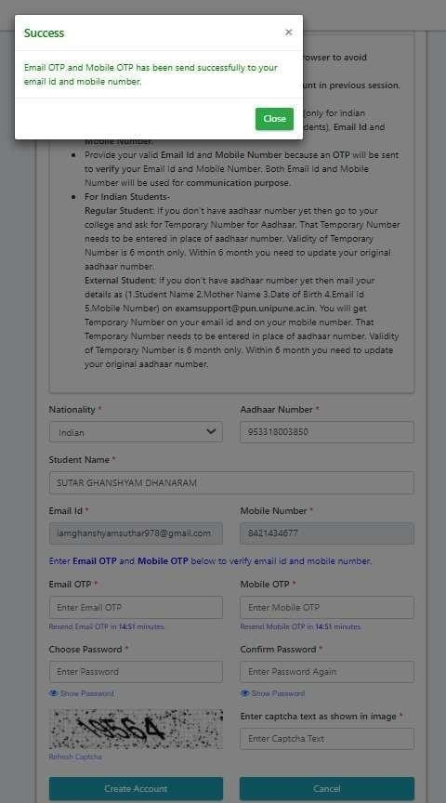
Step 7:
Message for OTP Click on “ Close”

Slide 12

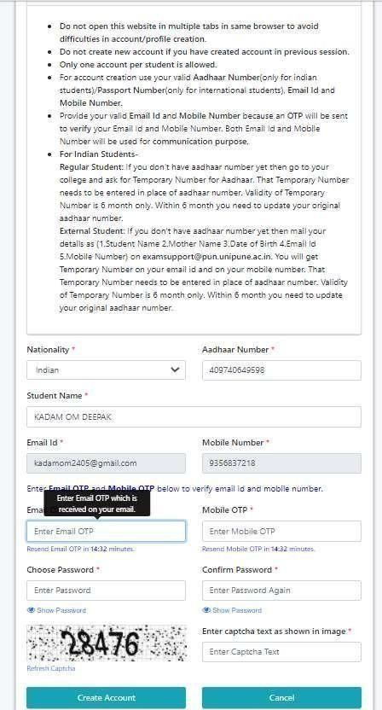
NOTE:
This is a Sample Form DONOT Use
the Details of this Form
{Use Your Details}
Step 8:
Enter the OTP received on Email & Mobile No. and Enter the Password of Your Choice (Combination of Only Alphabet & Numbers)
2) Enter “OTP Received
on Mobile”
1) Enter “OTP Received on Email”
3) Enter “ The Password of Your Choice” (Combination of Only Alphabet & Numbers Length of Password 6 to 10 Characters )
5) Enter “Captcha Text” (As Appeared)
4) Confirm the same password
(Preserve the Password for Future use
{Needfor next Three Yearsto fill Exam Forms})
6) Click on
“Create Account”

Slide 13

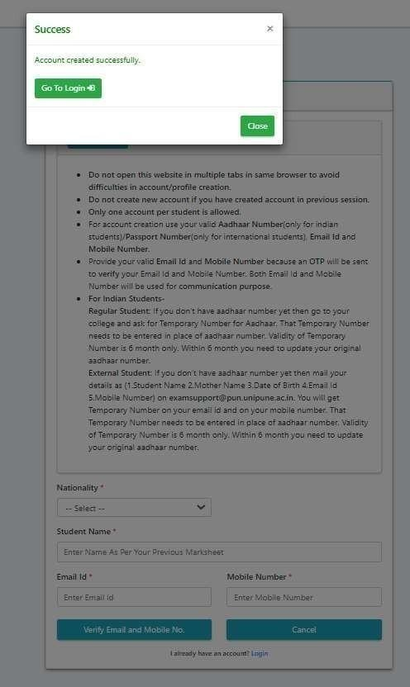
Step 9:
Message for Account Created Successfully Click on “ Go To Login”

Slide 14

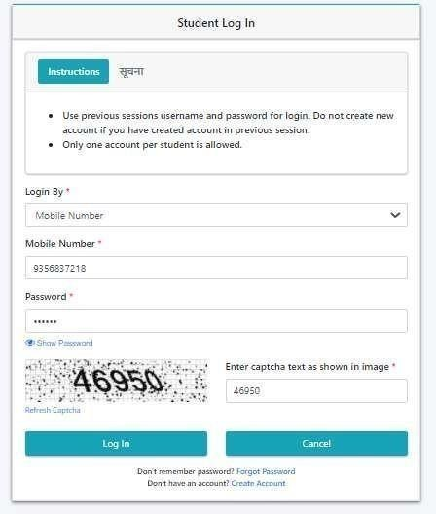
Step 10:
Login Window
Select the Option for Login By
(You can Login by
Mobile Number/Email/Aadhaar Number)
Enter the Details as required
Enter the Password created in Earlier Step
Enter “Captcha Text” (As Appeared)
Click on “Log In”

Slide 15

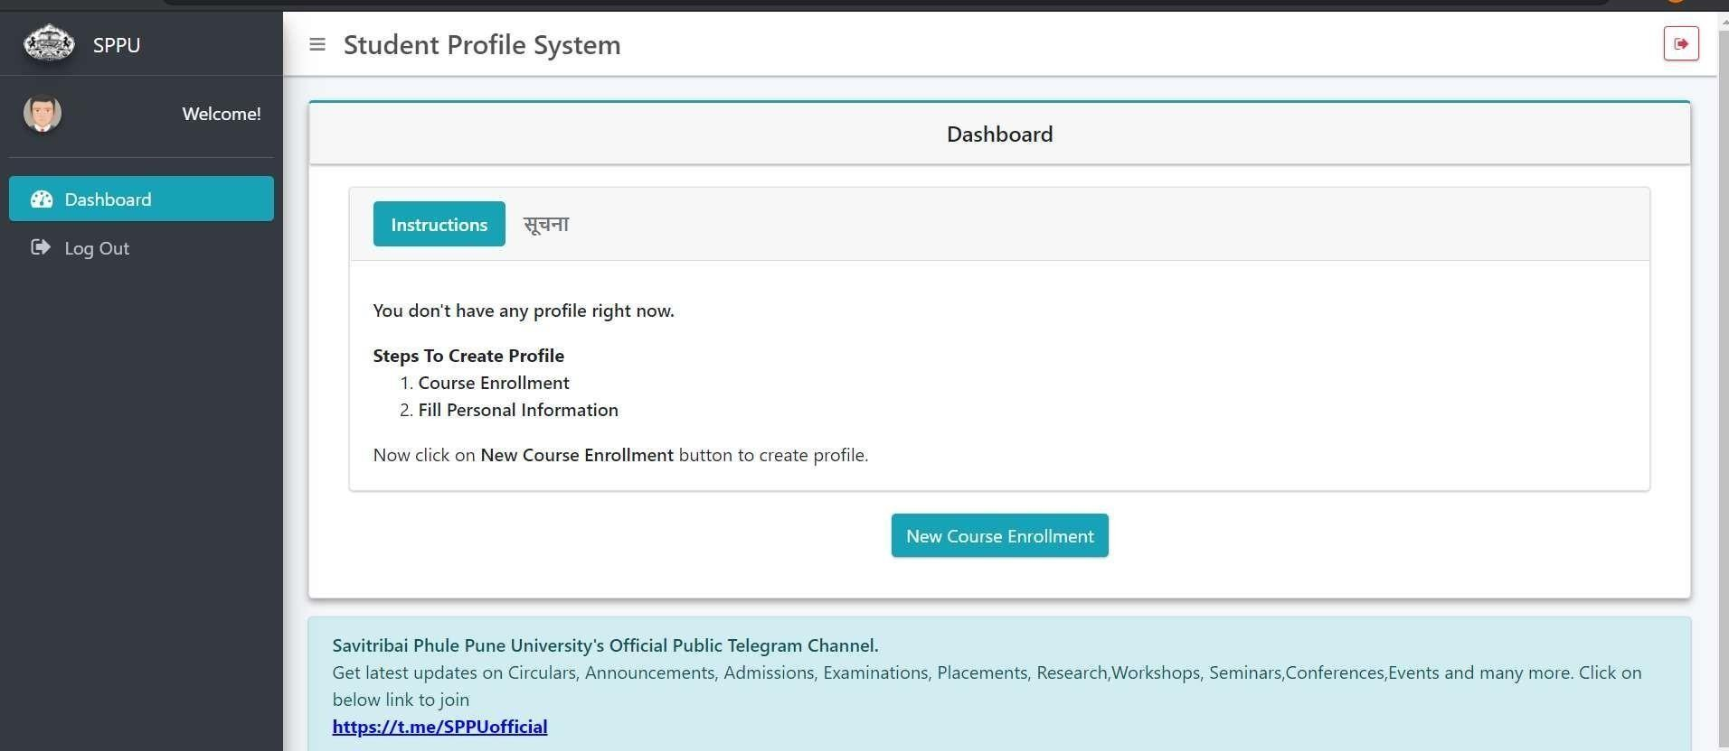
Step 11: Course Enrollment
Click on “ New Course Enrollment”

Slide 16

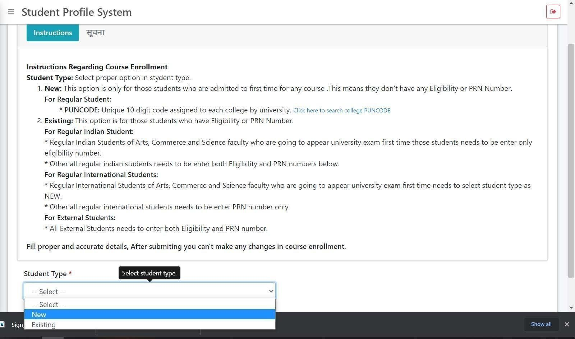
Step 12:
Select Student Type as “New”

Slide 17

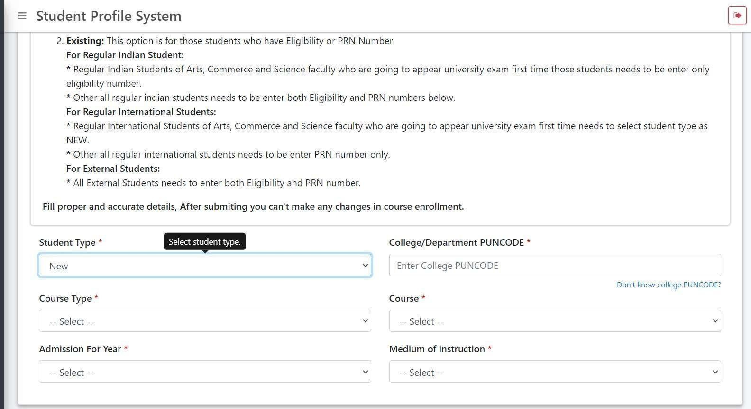
Step 13:
Enter College PUNCODE
CEGP013870

Slide 18

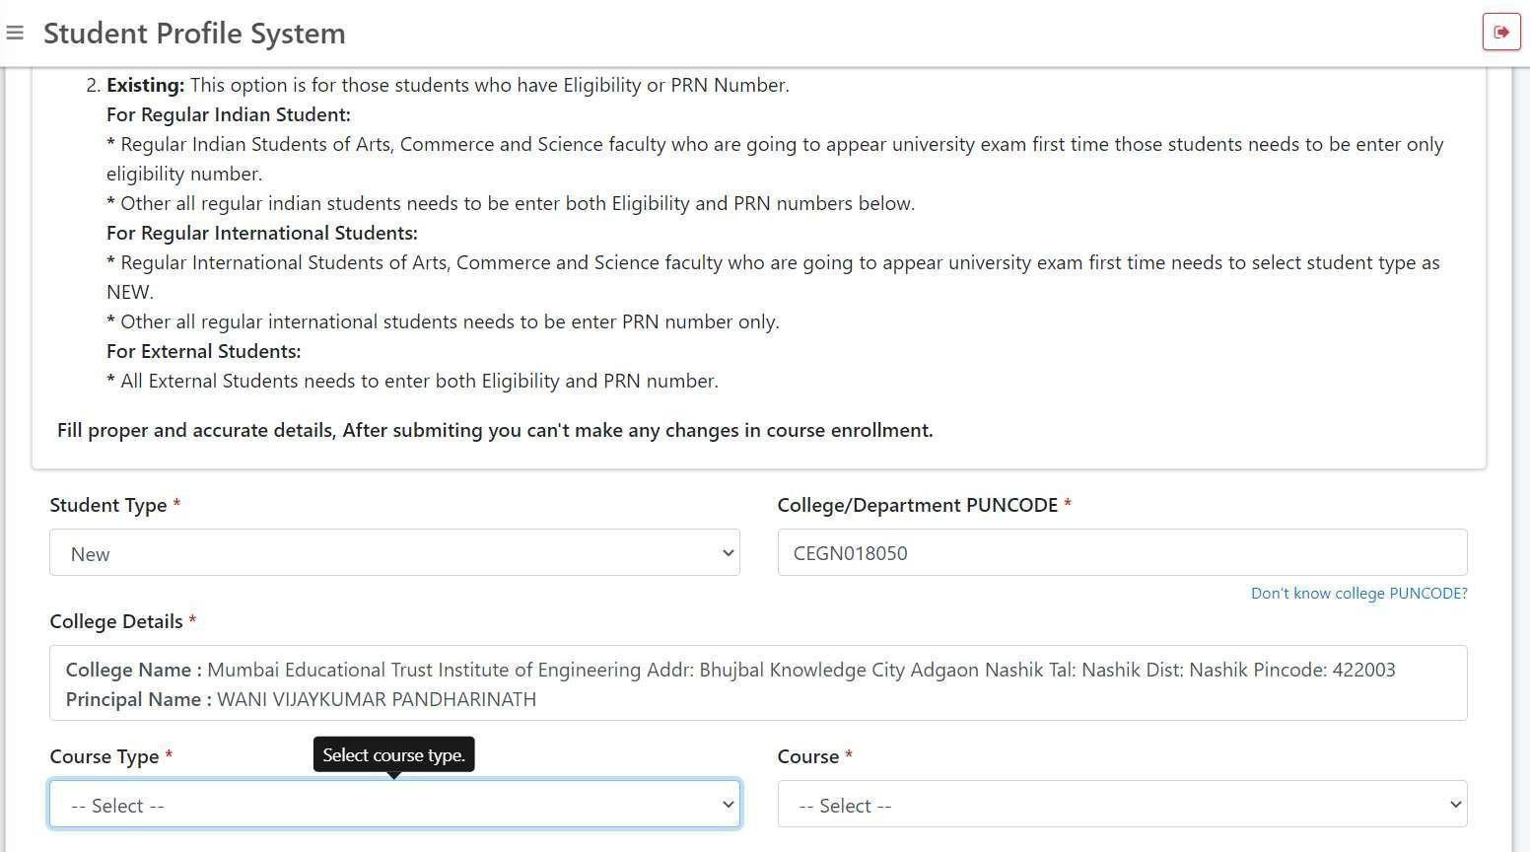
Step 14 Continued:
After Entering College PUNCODE
College Details will Appear along with Principal Name

Slide 19

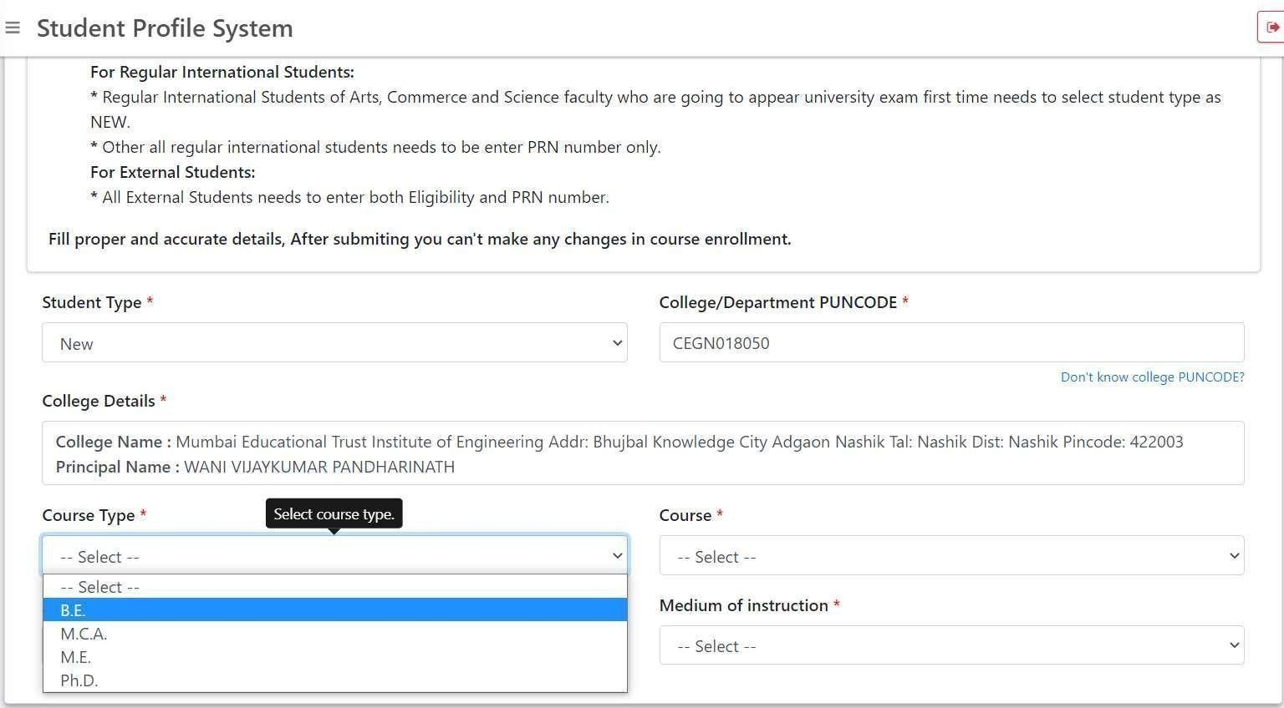
Step 15:
Select Course Type as “B.E.”

Slide 20

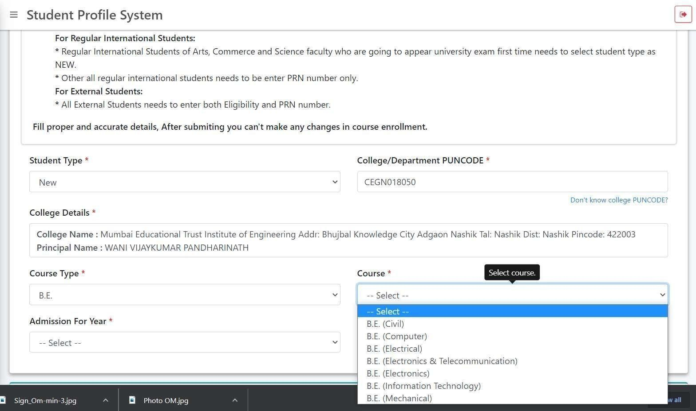
Step 16:
Select Course as per your Branch

Slide 21

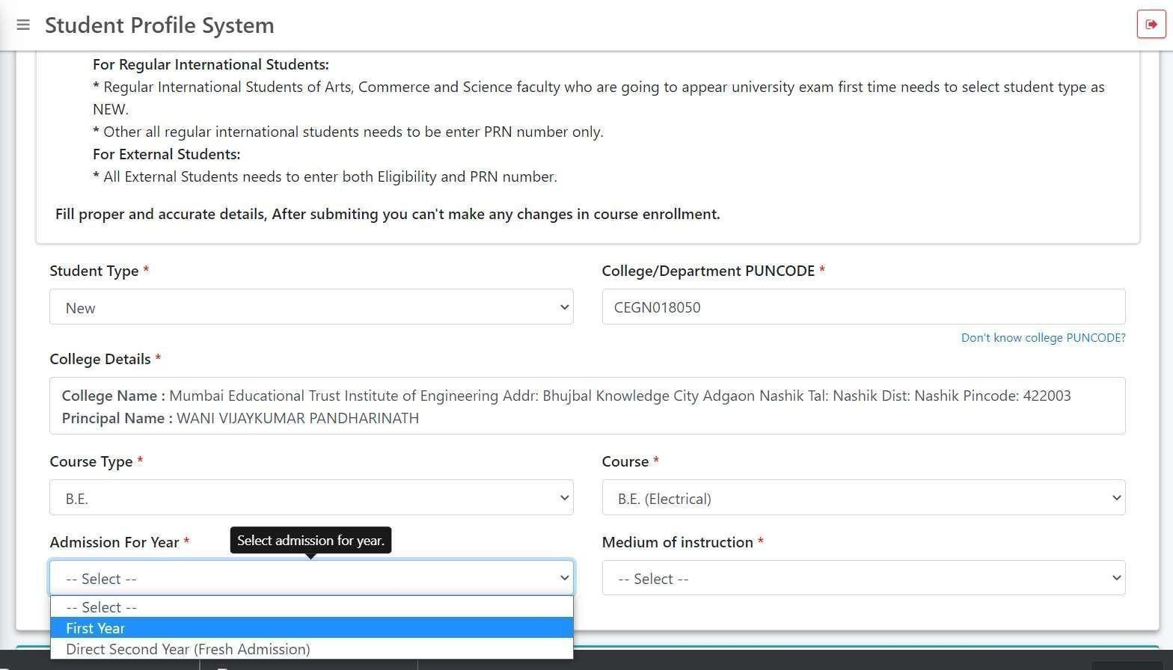
Step 17:
Select Admission For Year as “First Year/Direct Second Year”
Select Medium of Instruction as “English”

Slide 22

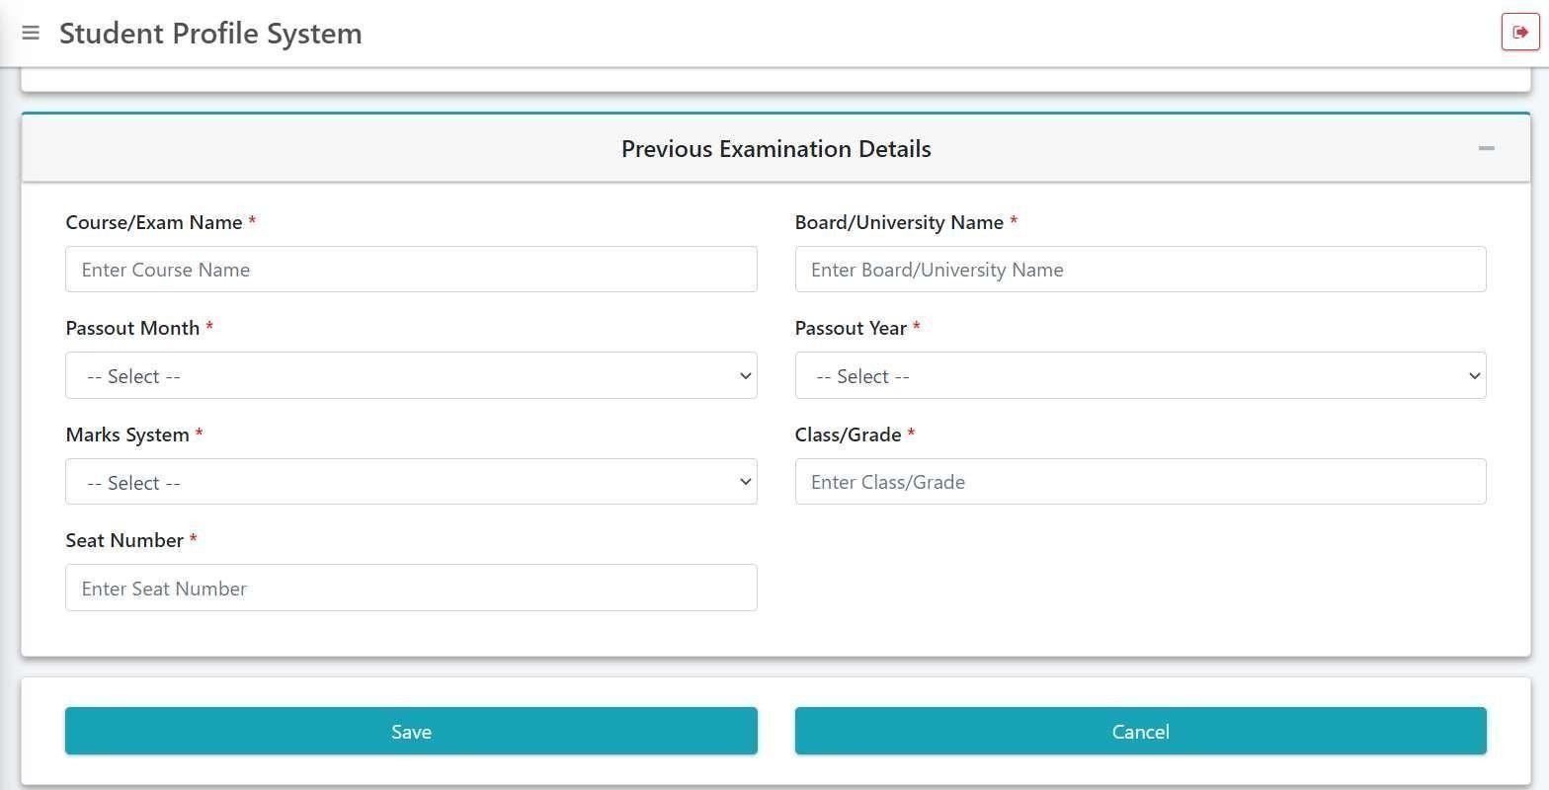
Step 18: Enter Previous Examination Details
Course/Exam Name: “Previous Exam” (e.g. HSC)
Board/University Name: As per Your Previous Exam Marksheet (For Example: Maharashtra State Board/CBSE/ICSEetc.)
Passout Month: As per Your Previous Exam Marksheet.
Passout Year: As per Your Previous Exam Marksheet.
Marks System: As per Your Previous Exam Marksheet. (Marks/Percentage OR CGPA/Grade)

Slide 23

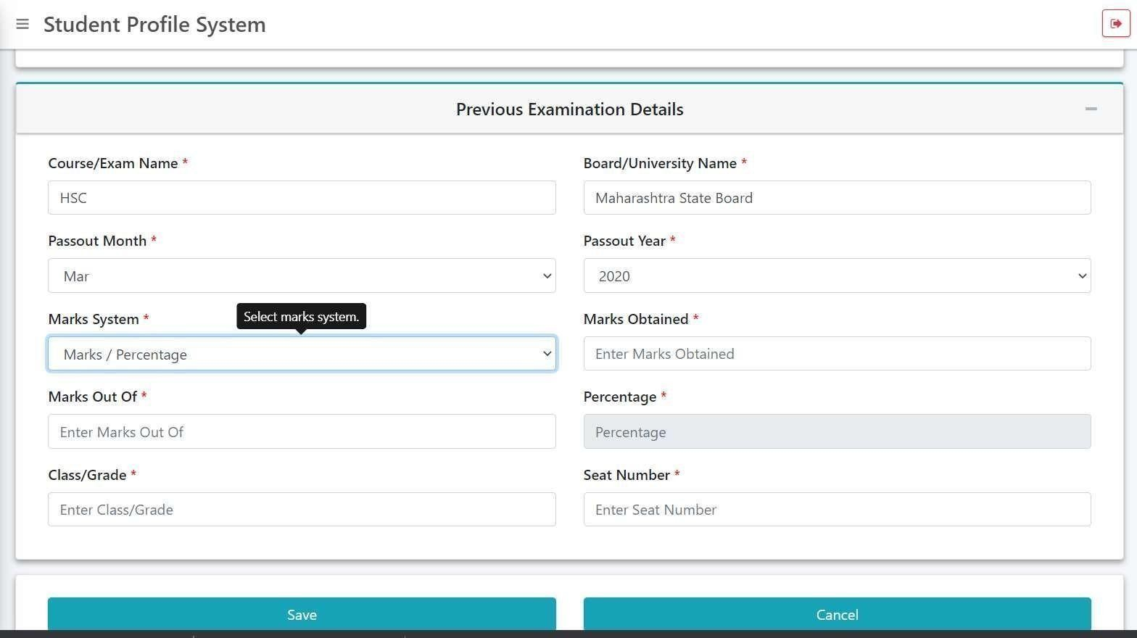
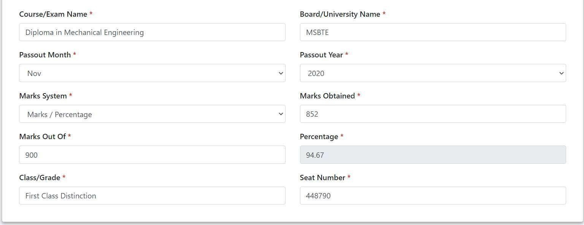
Step 18: Continued (For Marks/Percentage System)
If Marks System selected is “Marks/Percentage then Enter
Marks Obtained: As per Previous Exam Marksheet
Marks out of: As per Previous Exam Marksheet
Percentage: Will Automatically Come.
Class/Grade: As per Previous Exam Marksheet (If Not Mentionedthen Enter “Pass”)
Seat Number: As per Previous Exam Marksheet. & Click on “Save”

Slide 24

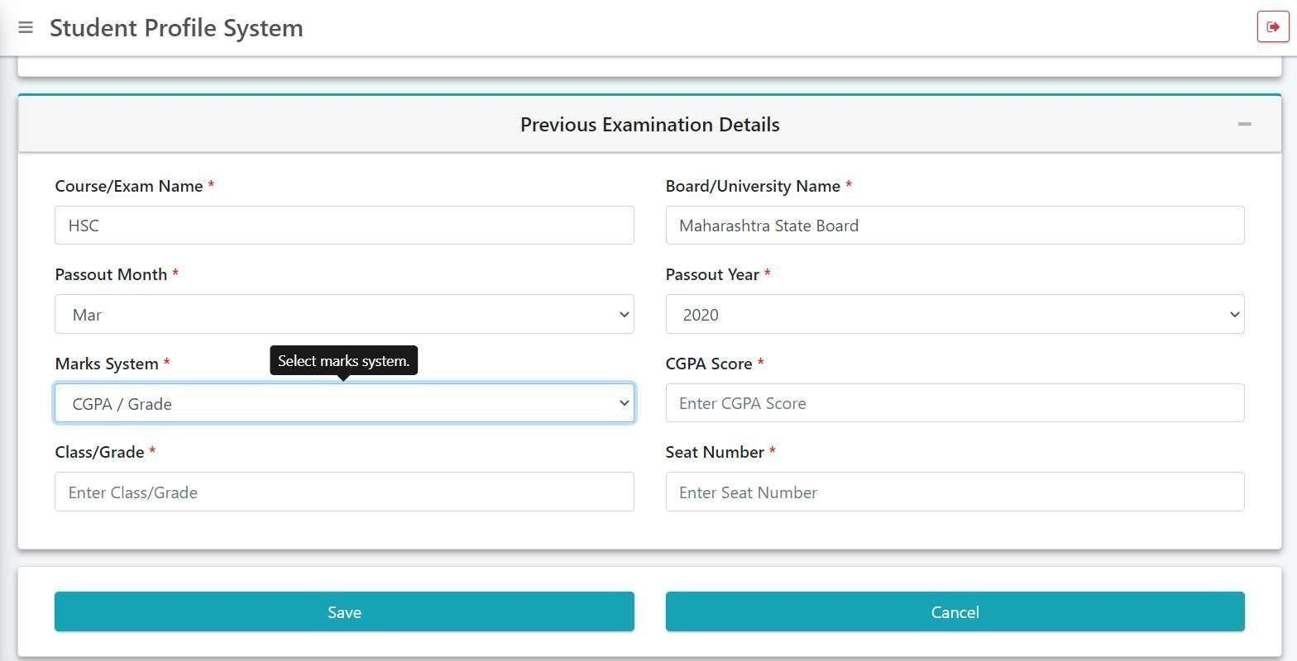
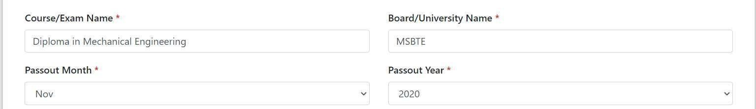
Step 18: Continued (For CGPA/Grade System)
If Marks System selected is “CGPA/Grade then Enter
CGPA Score: As per Previous Exam Marksheet
Class/Grade: As per Previous Exam Marksheet (If Not Mentionedthen Enter “Pass”)
Seat Number: As per Previous Exam Marksheet.
Click on “Save”

Slide 25

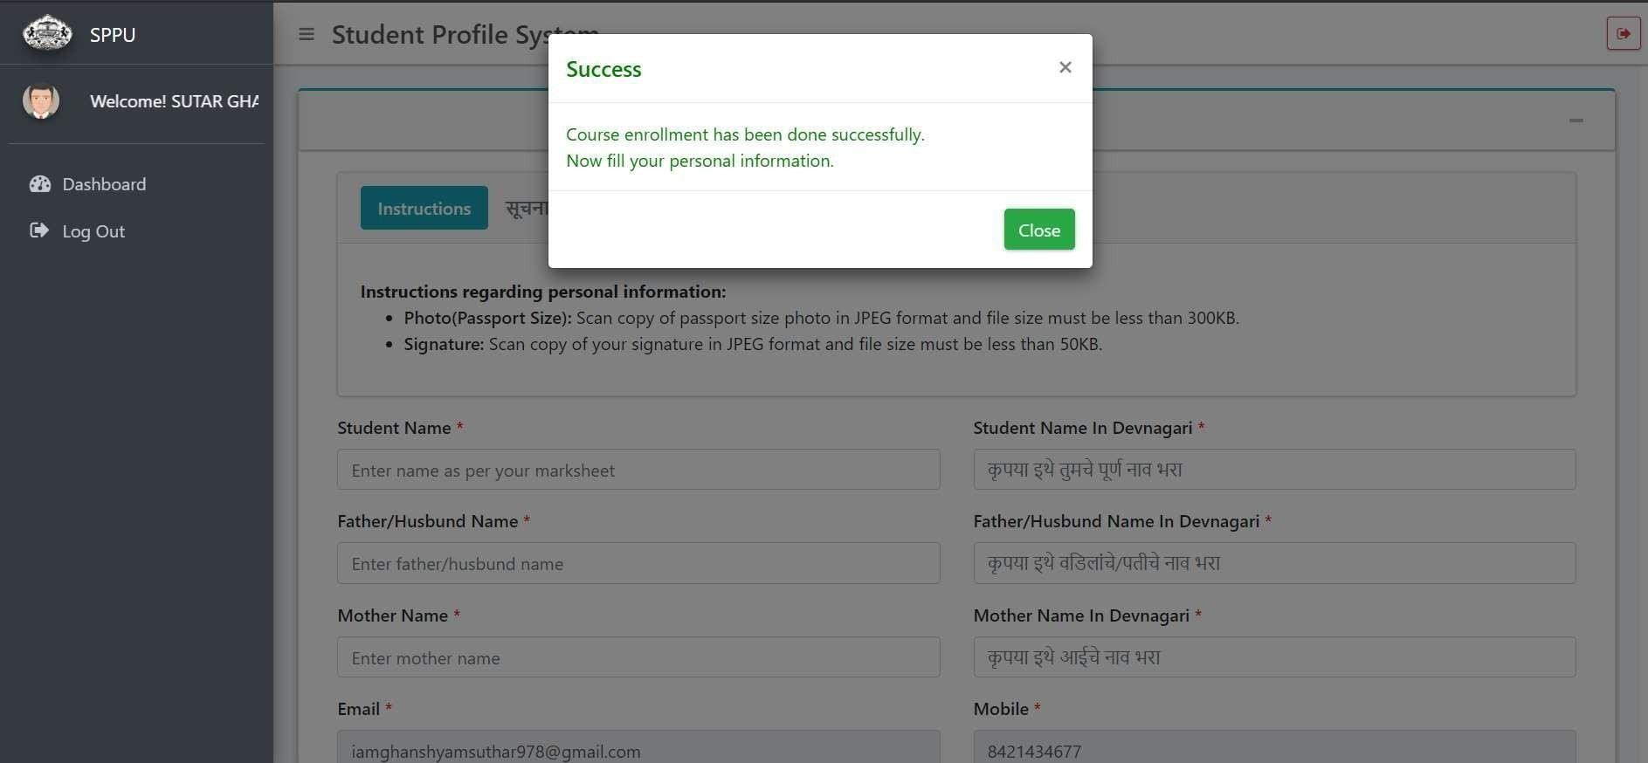
Step 19:
Message for Course Enrollment has been done Successfully Click
on “ Close” & Fill Your Personal Information

Slide 26

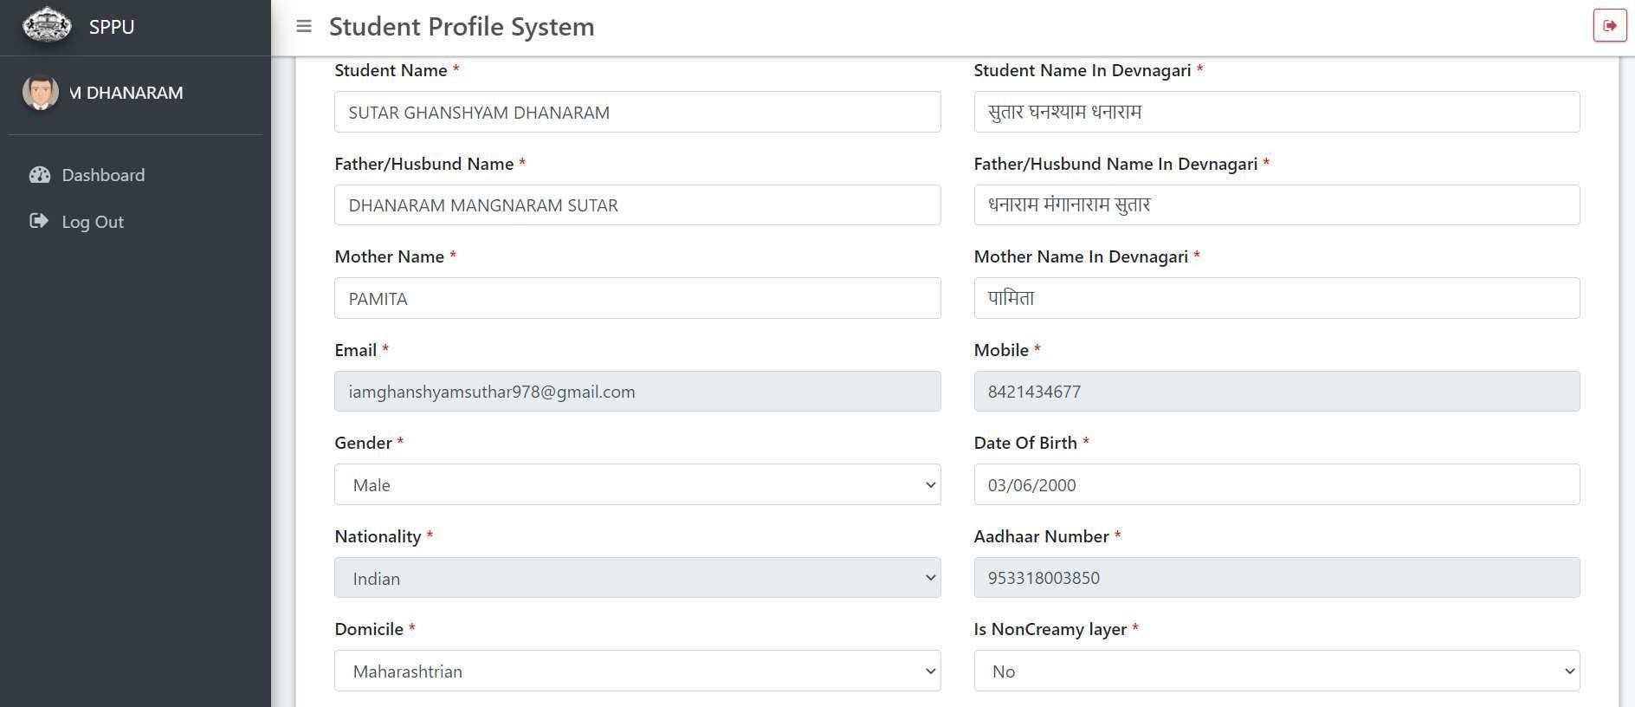
Step 19: Continued
Fill Your Personal Information Correctly step by step as required.
Student Name must be as per Previous Exam Marksheet.
Details in Devnagari: Try as per instructions (If facing problemthen type it in Mobile
Whatsapp in Marathi then Copy and Paste in requiredBlock)

Slide 27

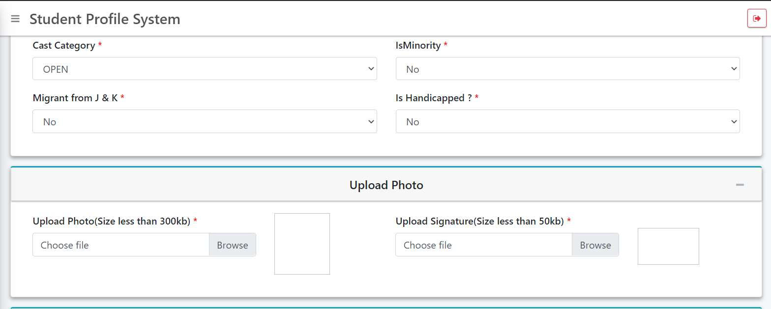
Step 20:
Upload Photo & Signature of Student (JPG format only)
Student Photo less than 300 kb Size.
Student Signature less than 50 kb Size. (Use Blue Ink for Signature) (Click on Browse and select the File for Photo and Signature)

Slide 28

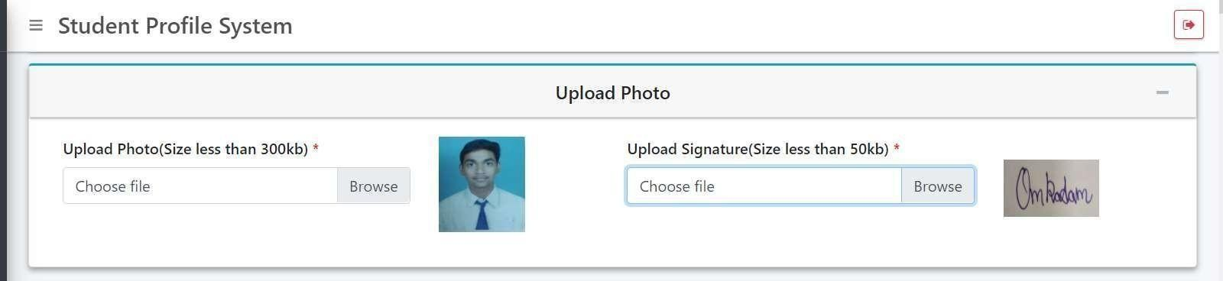
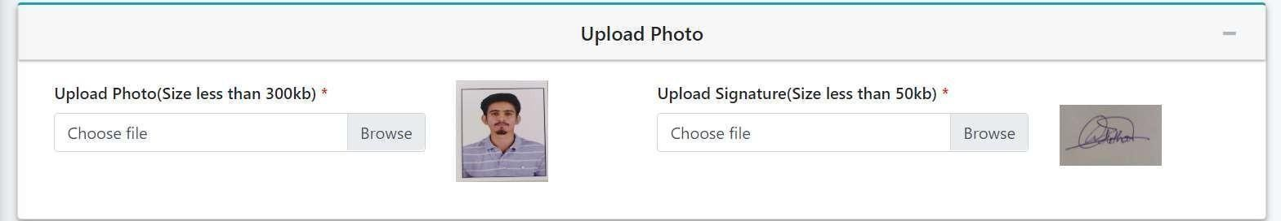
Example:
After Uploading Photo & Signature of Student, Your Photo & Signature will appear as shown above (Example).

Slide 29

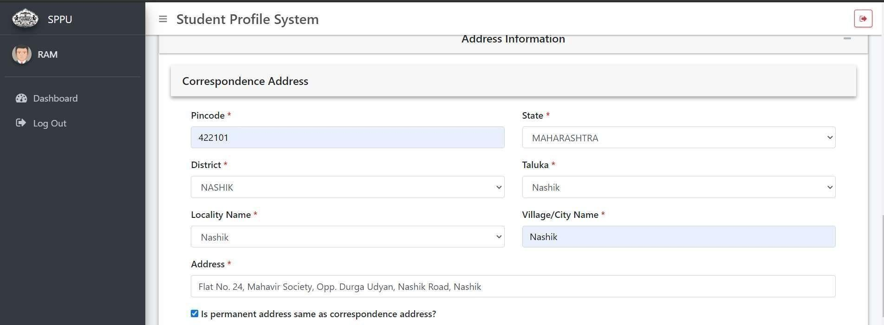
Step 21: Correspondence Address Details
Enter the Correct Pincode. (After Entering Pincode if StateDropdownmenu does Not appearor Error messagereflected then Logout and Login again {refer Step 1 to 4 and in step 5 insteadof Clicking on “Create
Account” Click on any one Link form Login Link 1 to Login Link 4 and login as per step 11} and click on Update Profile and Fill the Personal InformationAgain {Step19 & 20}) [This may happen due to Time Out]
Select the State, District, Taluka,Locality Name, Village/City etc.
Enter Detail Address
(Click on Check box if Permanent Address is same as Correspondence Address)

Slide 30

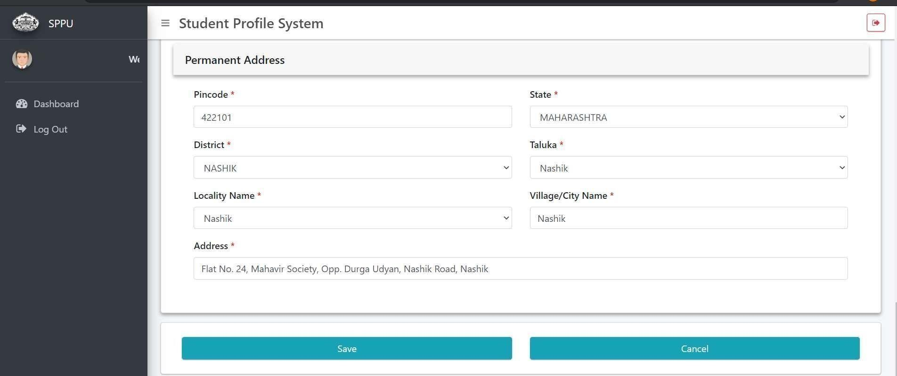
Step 21: Continued
If Permanent Address is Different than Correspondence Address then only Enter the Details otherwise the details will Automatically appear same as Correspondence Address.
Click on “Save”

Slide 31

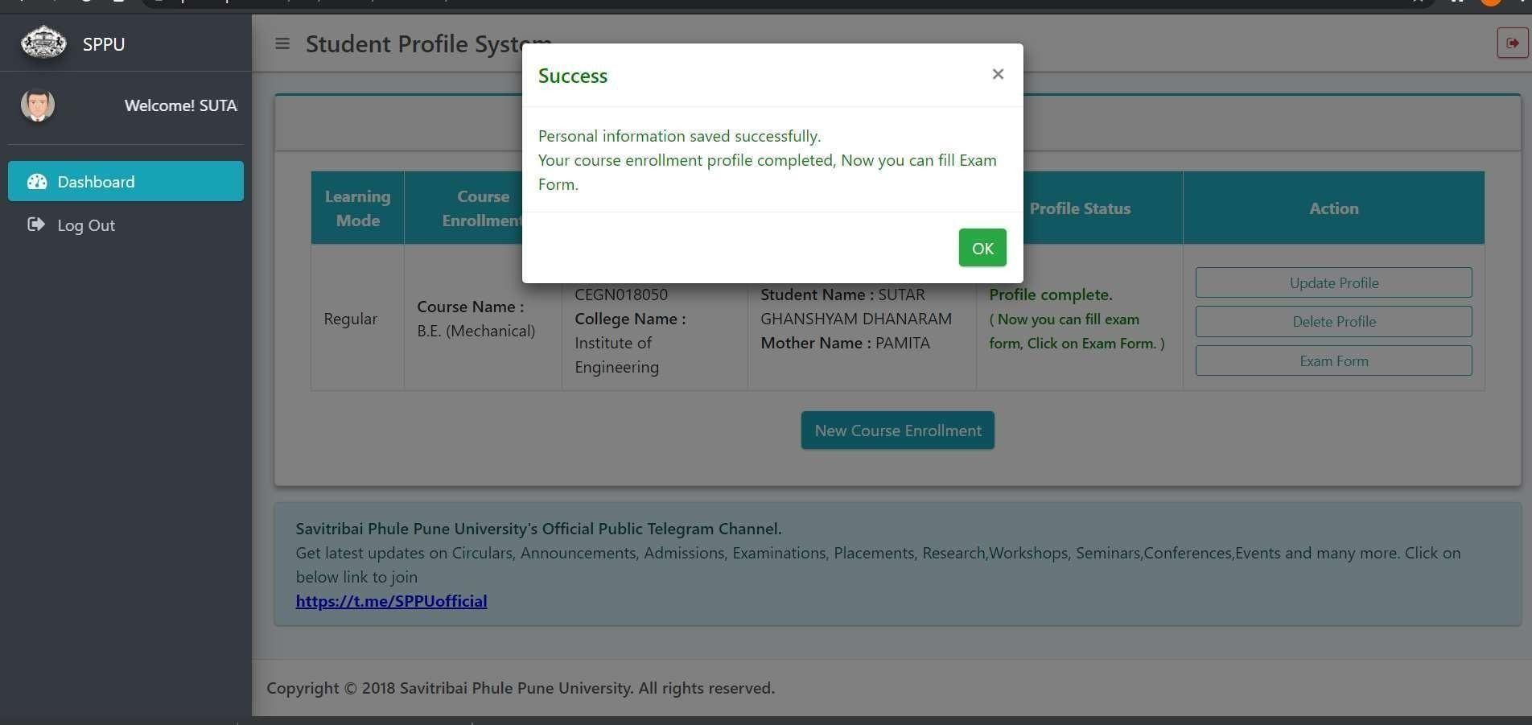
Step 22:
Message for Personal Information saved Successfully and Course Enrollment Profile Completed Click on “ OK”

Slide 32

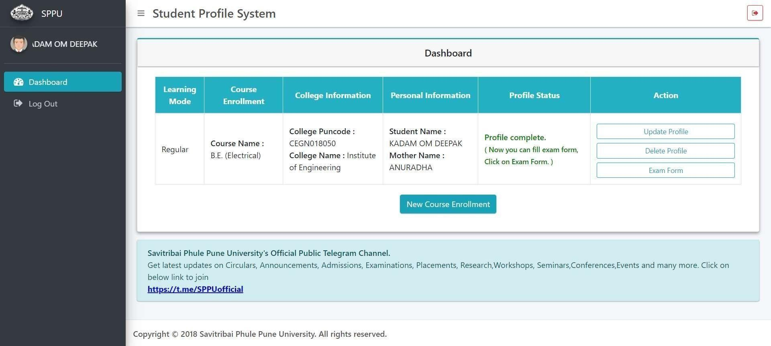
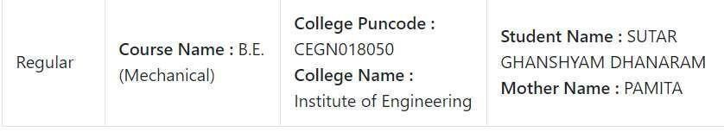


Click on “ Exam Form”
Step 22: Exam Form Filling Process

Slide 33

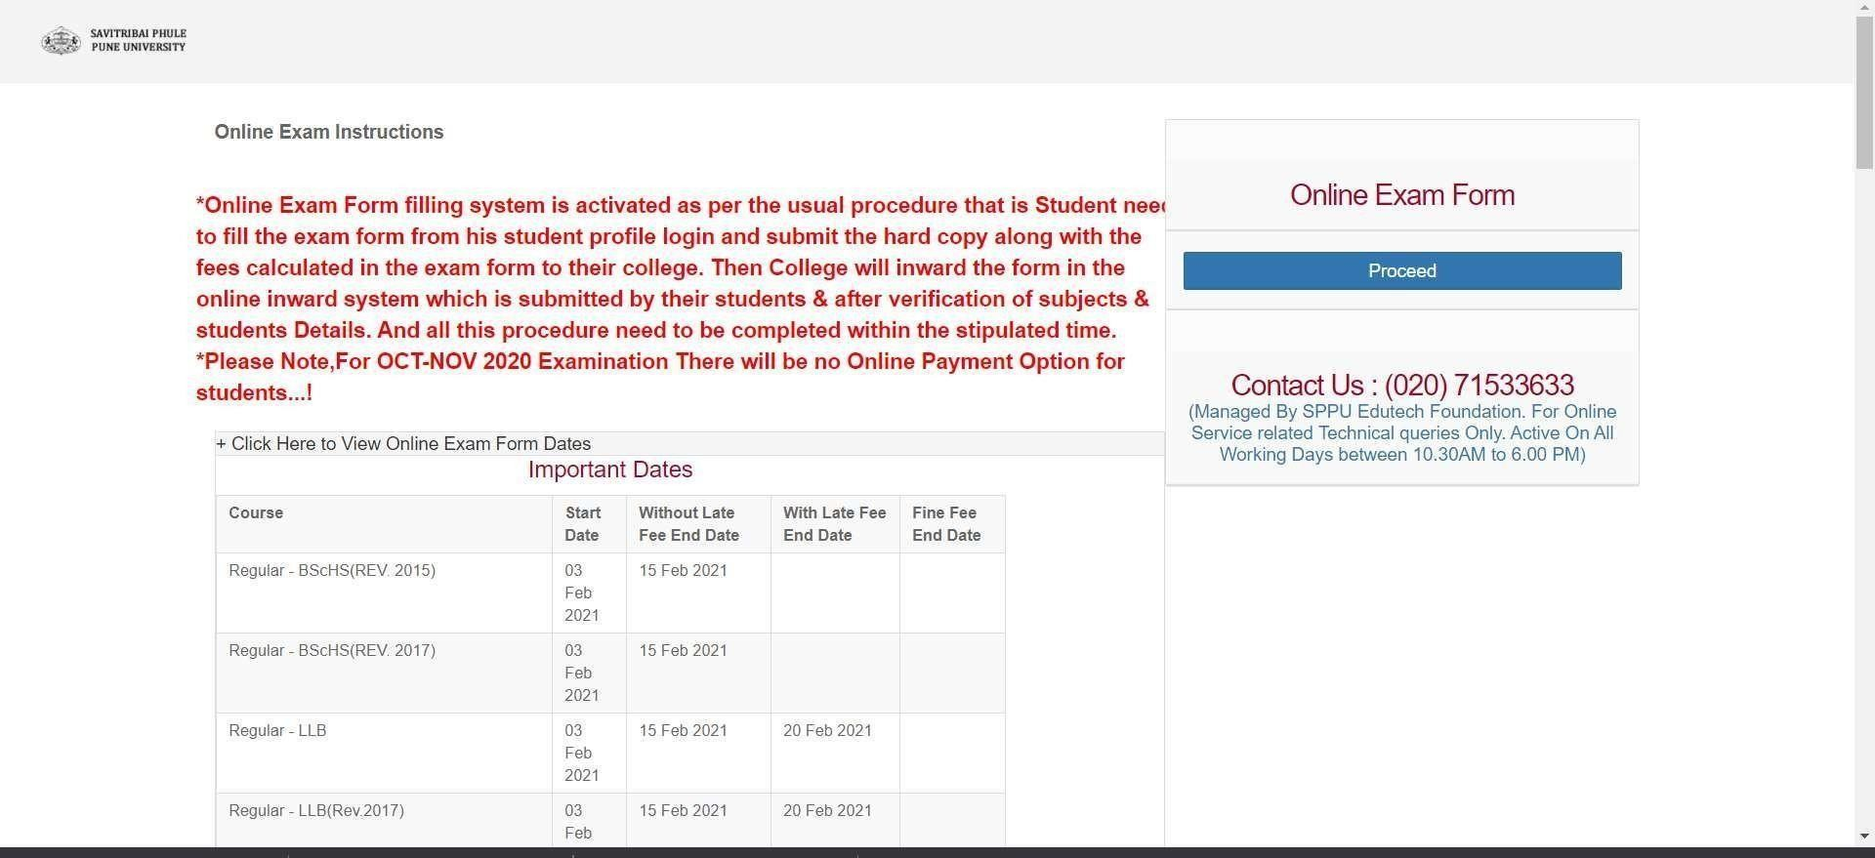
Step 23:
Click on “ Proceed”

Slide 34

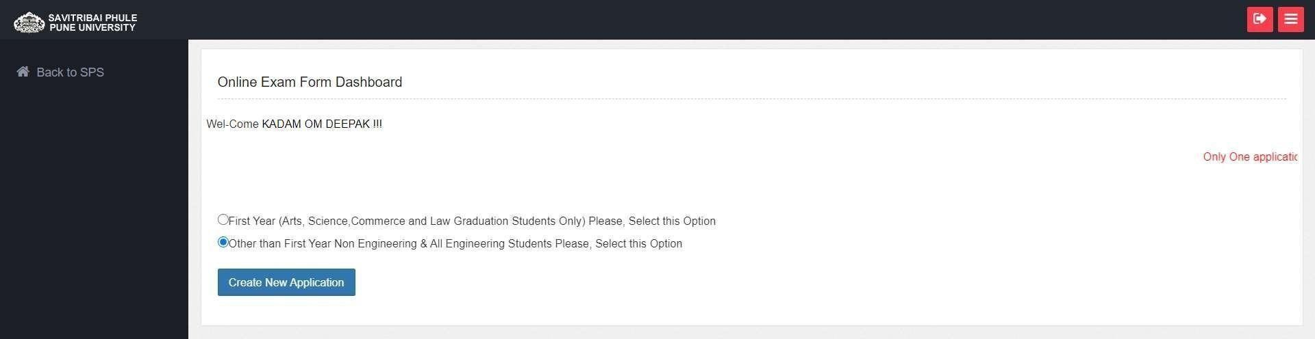
Check Your Name
Select Second Option
Then
Click on “Create New Application”
Step 24:

Slide 35

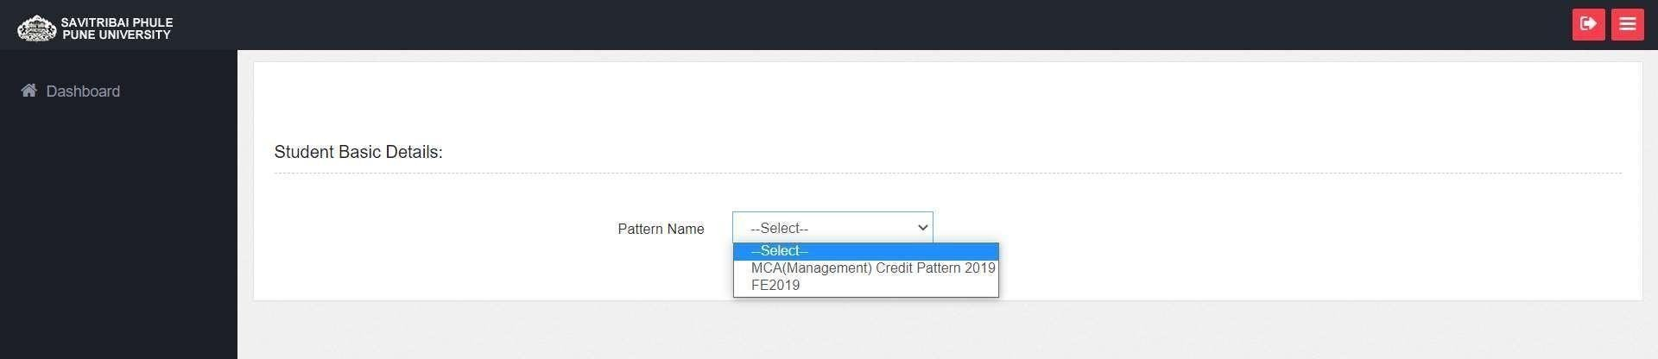
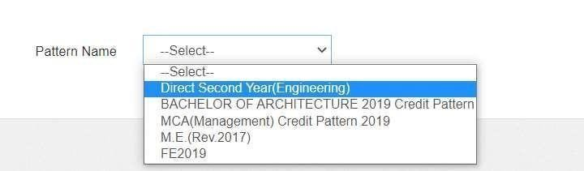
Step 25:
Select “FE2019”

Slide 36

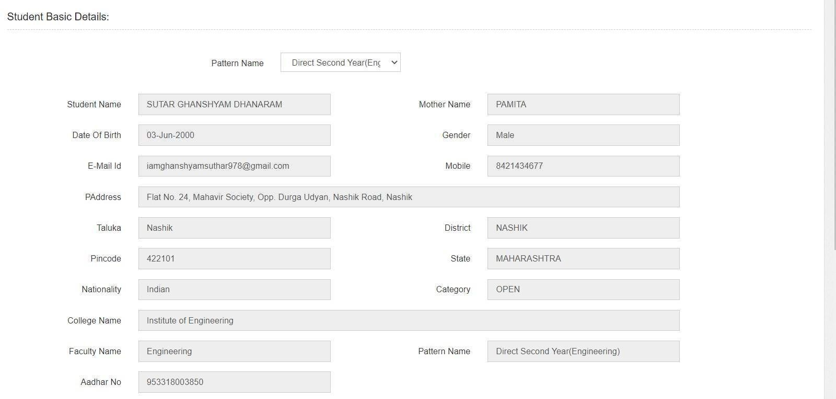

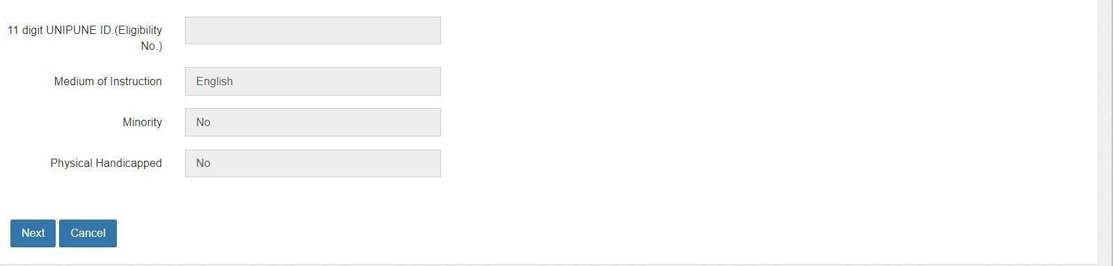
Step 26:
Check Pattern Name
Note: Check All Details
Click on “Next”

Slide 37

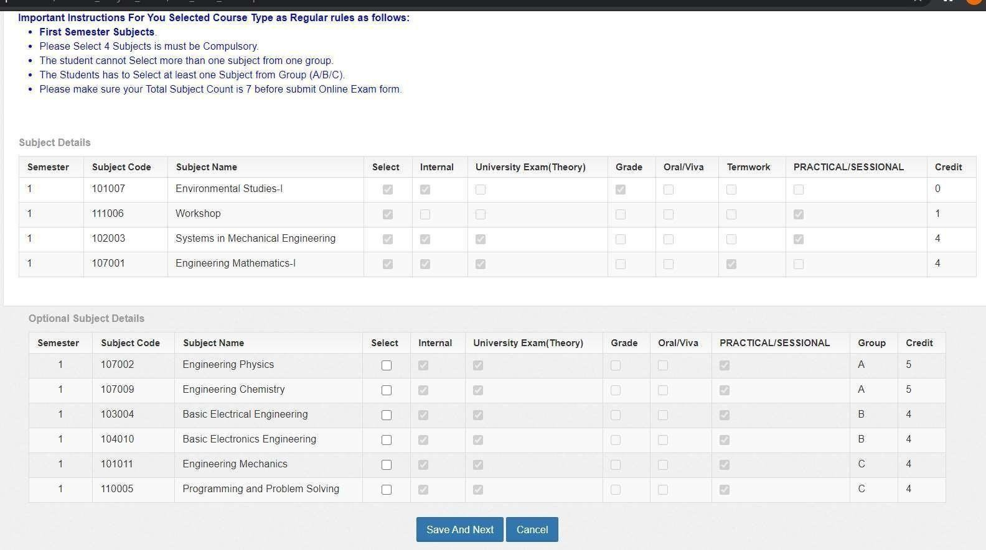
Step 27:
Very Important Note: Select the Correct Optional Subjects as per your Division(Ask to your Class Coordinator)
➢
➢
➢
One subject from Group ‘A’“Engineering Physics” & “Engineering Chemistry”.
One Subject from Group ‘B’ “Basic Electrical Engineering” & “Basic Electronics Engineering”. One Subject from Group ‘C’ “Engineering Mechanics” & “Programming and Problem Solving”.
After Selecting Correct Optional Subjects (Click on “Save And Next”)

Slide 38

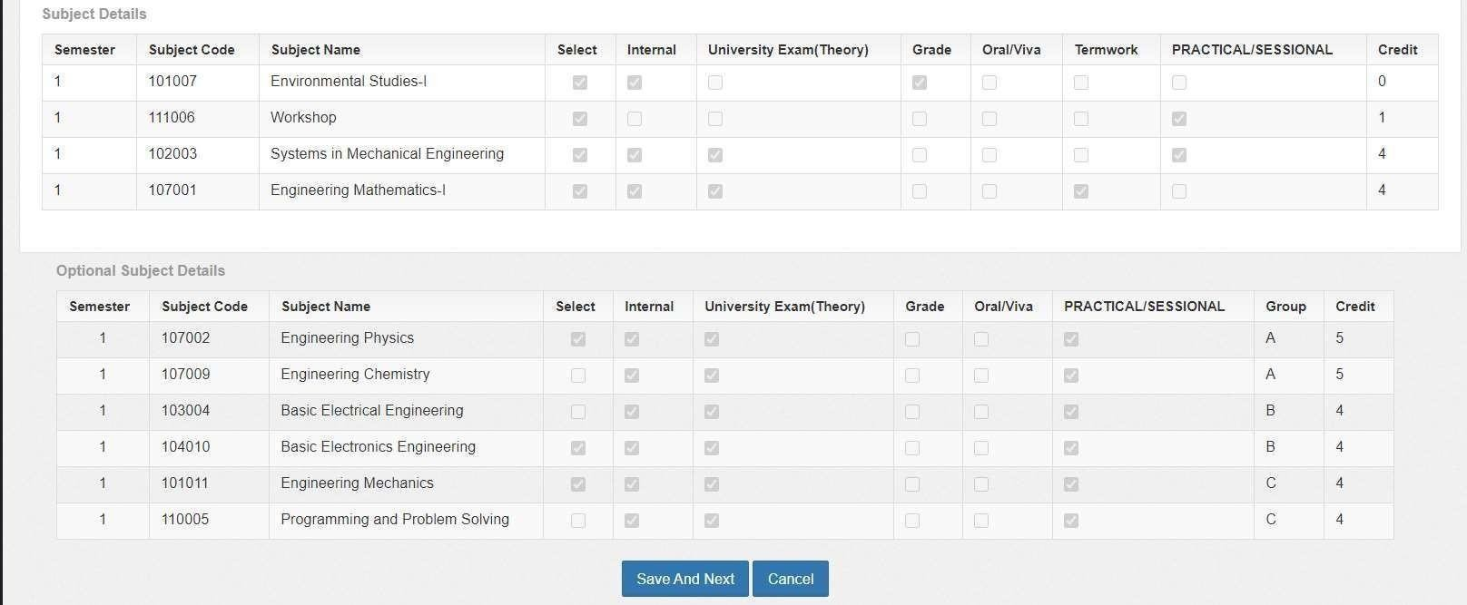
Step 28:
Example: This is Just a Example (Ask the Optional Subjects to YourClass Coordinator) After Selecting Correct Optional Subjects, It will appear as mentioned Above.
Then (Click on “Save And Next”)
Very Important Note: Select the Correct Optional Subjects as per your Division (Ask to your Class Teacher)
➢
➢
➢
One subject from Group ‘A’“Engineering Physics” & “Engineering Chemistry”.
One Subject from Group ‘B’ “Basic Electrical Engineering” & “Basic Electronics Engineering”. One Subject from Group ‘C’ “Engineering Mechanics” & “Programming and Problem Solving”.
After Selecting Correct Optional Subjects (Click on “Save And Next”)

Slide 39

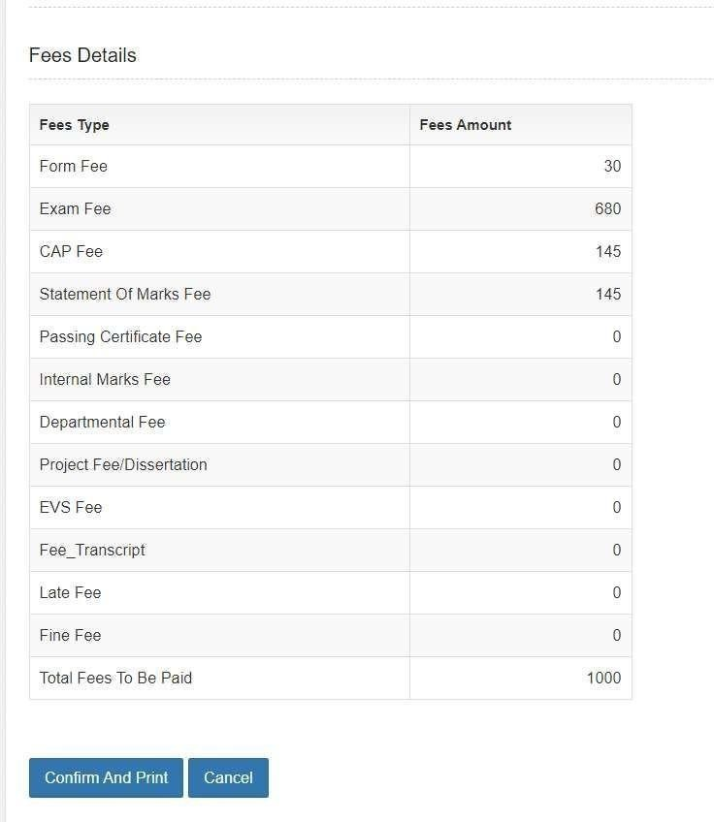
Step 29:
Fees Details:
Once You Click on “Save And Next” Fees Details will Appear as shown.
Click on “Confirm And Print”

Slide 40

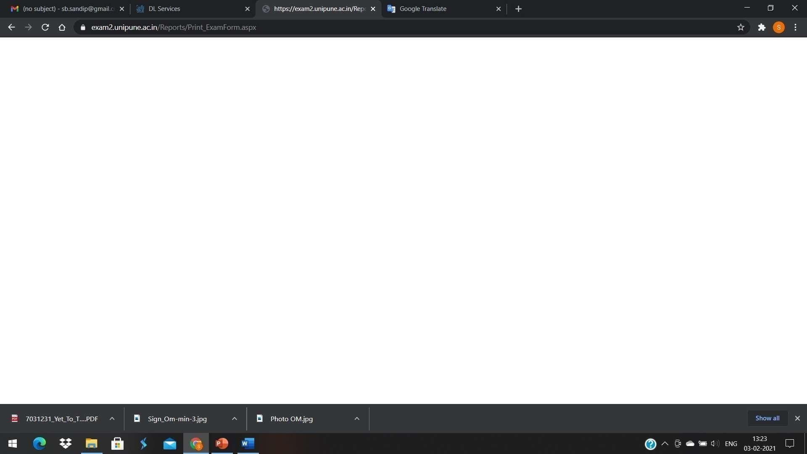
MET Institute of Engineering
After Click on “Confirm And Print”, if Nothing is Appearing then Close the Window and Login again
Refer Step 1 to 4 and in step 5 instead of Clicking on “Create Account” Click on any one
Link form ‘Login Link 1’ to ‘Login Link 4’ and login as per step 11 and Click on “Exam Form” then Exam Form Details will be displayed then click on “Print” to download the
PDF of Exam Form Application (See Next Slide)

Slide 41

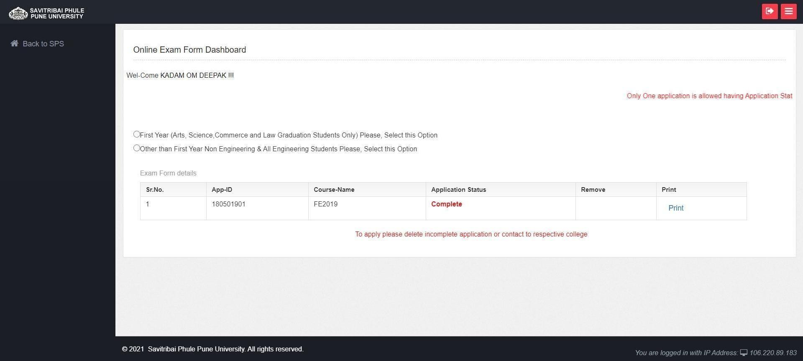
Step 30:
“Logout Button”
After Click on “Print”,
PDF of Exam Application Form will be Downloaded. Save the PDF and Note Down the Application ID (See TopRight Corner of PDF) (e.g 1805-0 ). (Do Not Forget to Logout)(To Logout Click on
“Arrow Icon” Given on Right Top Corner)
Click on “Print”
*** END of Exam Form Filling Process ***

Slide 42

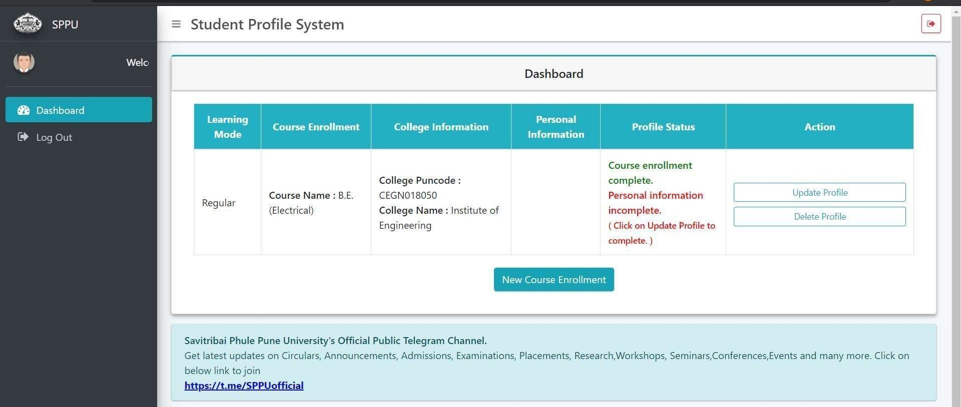
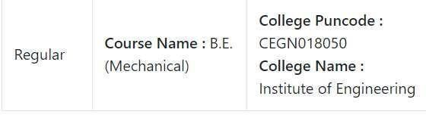
Use This Step Only If Profile Status is Incomplete
If in Case SPPU Site is not Responding or any network connectivity issue or Time out issue in between Course Enrollment/Personal Information filling, Then Logout and Login again to complete the Profile.
Refer Step 1 to 4 and in step 5 instead of Clicking on “Create Account” Click on any one Link form Login Link 1 to Login Link 4 and login as per step 11.
Following window will Appear then Click on “Update Profile” and proceed as per steps mentioned.

Slide 43

Last Step
Download the Exam Form
Take signature of GFM and class teacher on exam form
Submit Exam form at account section
Pay the exam form fees if not paid while taking admission
Important Note:
If You Fail to Submit the Exam Form within deadline You will not be Allowed to appear for Examination.

